Slide 1

Building a Robust Hospital Management System
Presented by: Ravikant Turi, Infinite Computer Solutions

Slide 2
Project Overview: Hospital Management System
Our project focuses on developing a comprehensive Hospital Management System designed to streamline administrative tasks, enhance patient care, and manage critical hospital operations efficiently. This presentation will detail the insurance administration module, a key component enabling flexible policy management for individuals and families.

Slide 3
Insurance Module: Core Functionality
Individual & Family Plans
Flexible Plan Configuration
Membership Rules
Designed the capability to create and manage insurance policies for both individual patients and entire families, ensuring comprehensive coverage options.
Integrated features to set and enforce member rules for each insurance plan, dictating the number of individuals permitted under a family policy.
Implemented a robust system allowing administrators to define various insurance plans with specific coverage tiers (Silver, Gold, Platinum).

Slide 4
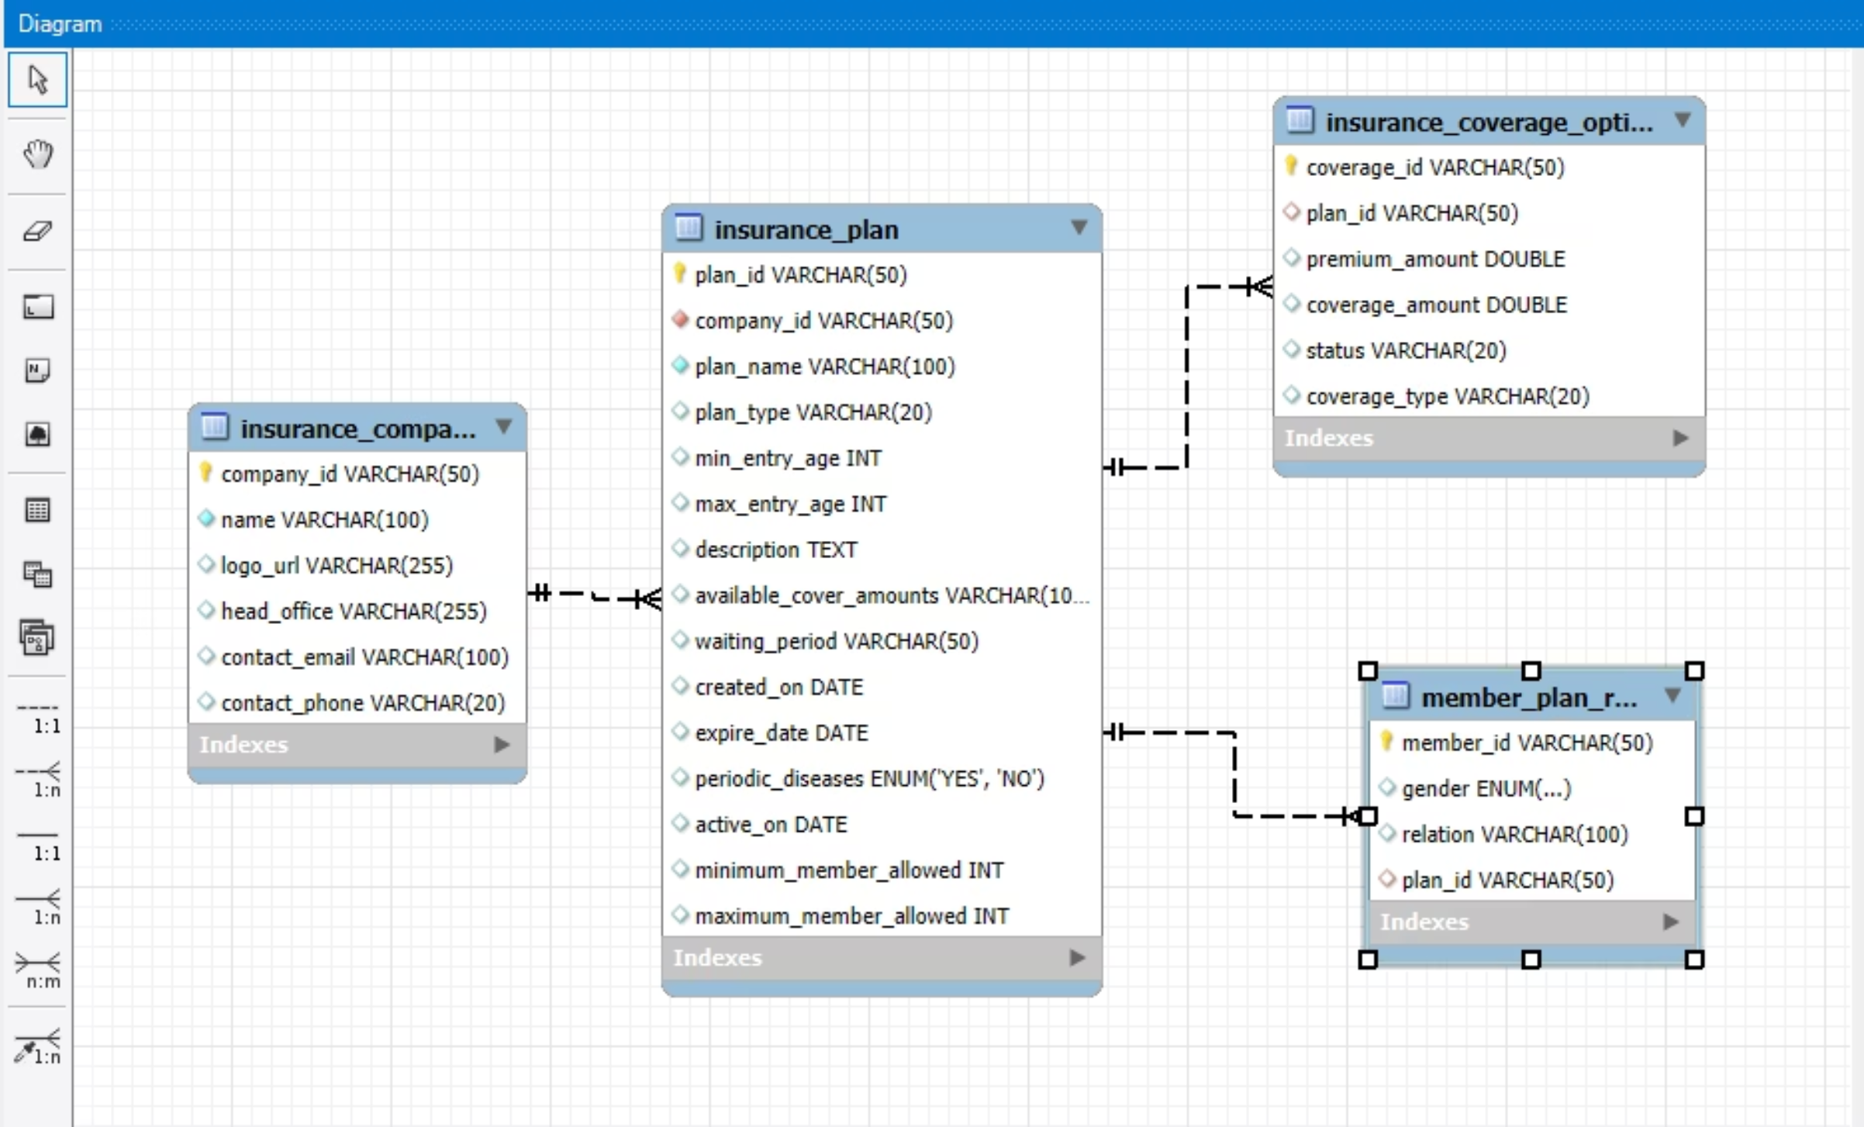
Database Schema: Insurance Module
The insurance module's data structure is built upon four interconnected tables, ensuring data integrity and efficient retrieval of policy information. This normalized schema supports granular control over insurance companies, plans, coverage, and member rules.

Slide 5
Architecture: MVC & Layered Design
The system adheres strictly to the Model-View-Controller (MVC) architectural pattern, promoting separation of concerns and maintainability. This layered approach enhances modularity, scalability, and ease of development.
Model Layer
View Layer
Data logic and persistence
User interface representation
Business rules implementation
JSF (JavaServer Faces) for frontend rendering
Hibernate 3.6 for ORM

Slide 6
Controller Layer
Constants & Utilities
Handles user input
Centralized configuration files
Interacts between Model and View
Reusable utility functions
Manages application flow
Enhances code consistency
This structured approach significantly improves code organization and simplifies debugging processes.

Slide 7




Technology Stack
Java
MySQL
Primary programming language for backend logic and application development, leveraging its robust ecosystem.
Relational database management system for storing and managing all system data, including patient records and insurance details.
Hibernate 3.6
Log4j
Object-Relational Mapping (ORM) framework for efficient database interaction and data persistence.
Logging framework used for debugging, error tracking, and monitoring application behavior in real-time.

Slide 8
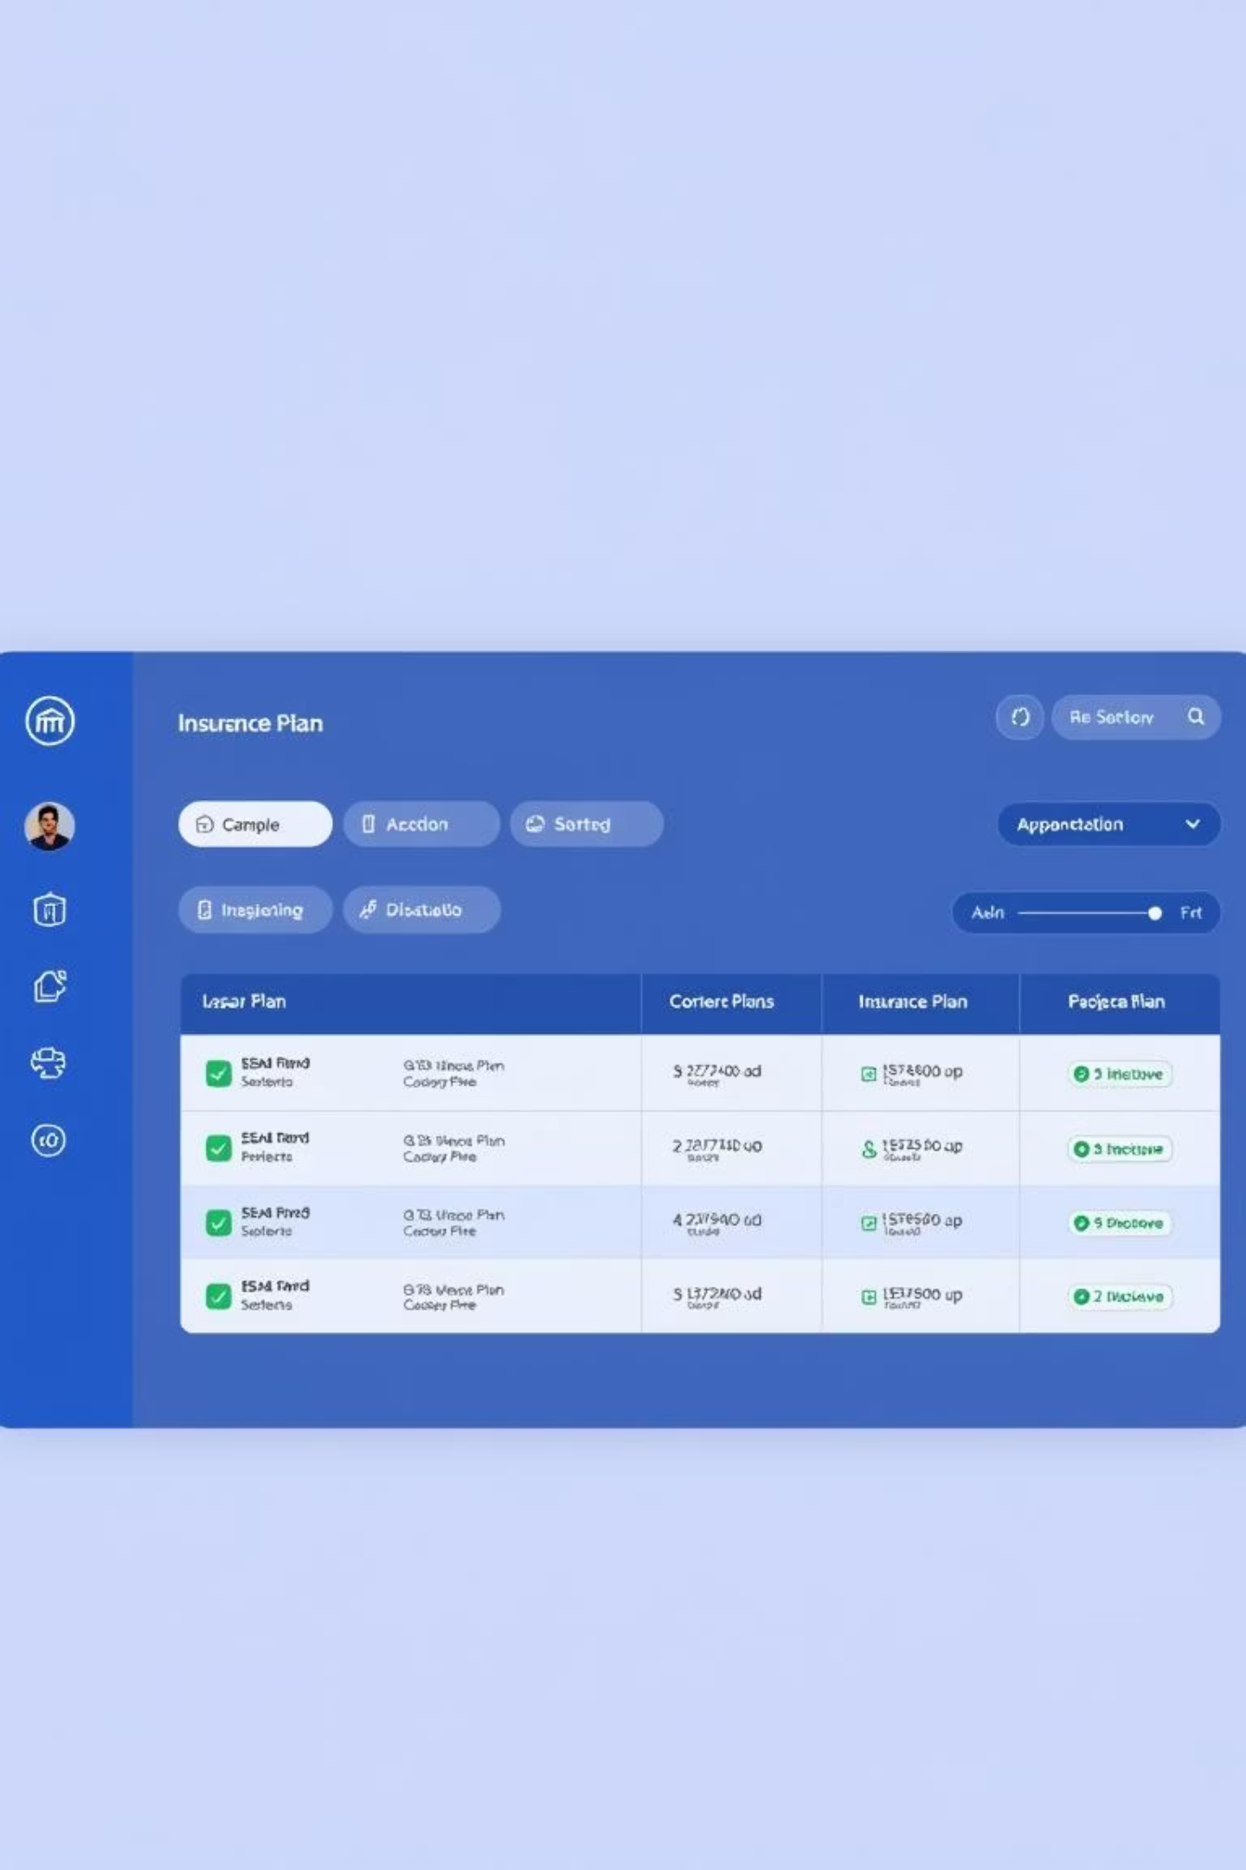
Admin Dashboard: Insurance Management
The administrator dashboard provides a centralized interface for managing all insurance-related data. This includes creating new insurance plans, modifying existing ones, and viewing all active policies.

Slide 9
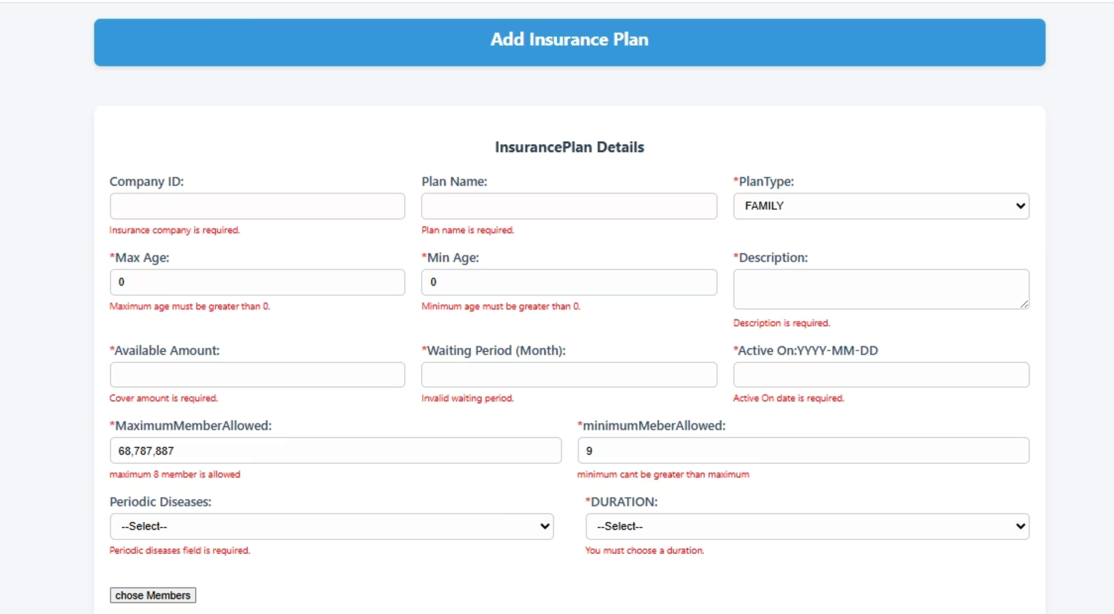
Validation

Slide 10
Key Features: Dashboard Usability
1
Efficient Data Display
2
Dynamic Sorting
3
Seamless Pagination
Implemented sorting capabilities for various columns (e.g., plan name, company, coverage level) to enable quick data retrieval and analysis.
All insurance plans are displayed in a clear, tabular format, providing a quick overview of available policies and their attributes.
Designed pagination controls to manage large datasets, ensuring optimal performance and user experience when browsing numerous insurance plans.

Slide 11
Conclusion & Future Scope
The insurance administration module successfully provides a robust and flexible solution for managing diverse insurance plans within the Hospital Management System.
Future enhancements could include integration with external insurance providers' APIs and advanced reporting features for policy utilization.
This project demonstrates a solid foundation for scalable and maintainable enterprise applications.

